Slide 1








TEXT ANALYSIS ON BREAST CANCER USING REDDIT POST
IST 736 TEXT MINING FINAL PROJECT
Team Members:
-Sravan Kumar Mangalagiri
-Kavya Darsi
-Abirami Rajalingam

Slide 2

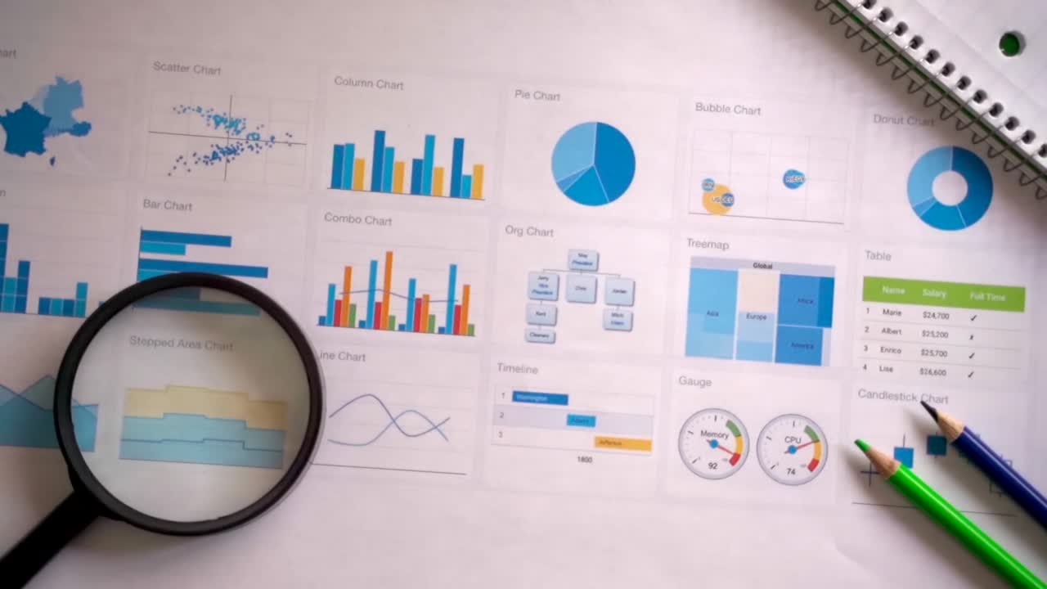
Agenda
Project Scope Goals
Result and Interpretation
Challenges and Solutions

Slide 3
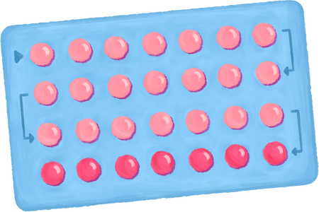




Progress
We managed to do a Q&A model chatbot which works primarly with words.
Used TF-IDF vectorizer and clean text loop to get the meaningful insights.
We performed LDA and BERT to do the topic modelling on Questions

Slide 4
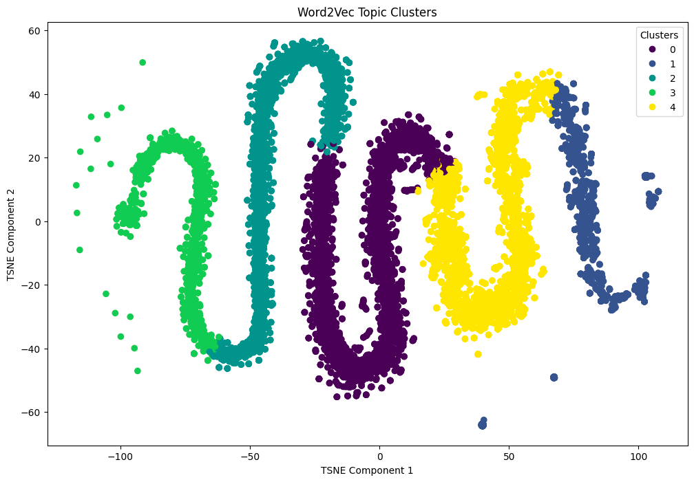
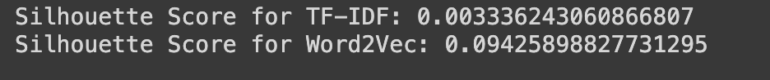
Word2Vec Usage

Slide 5
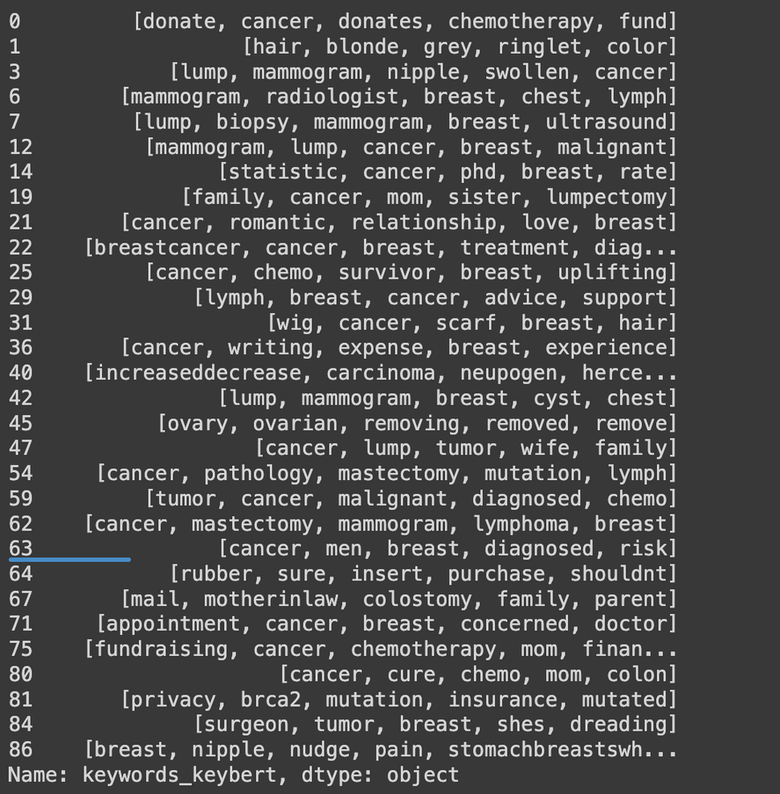
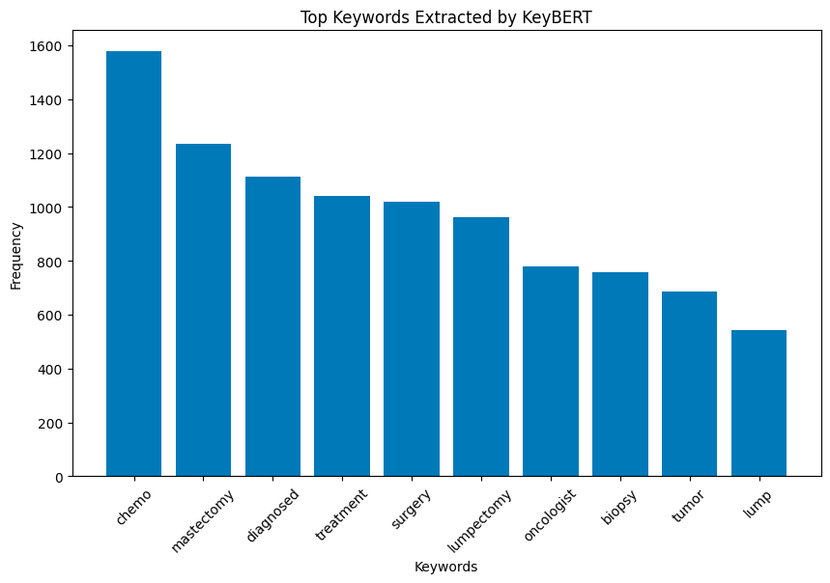
Keywords Extraction using KeyBERT

Slide 6
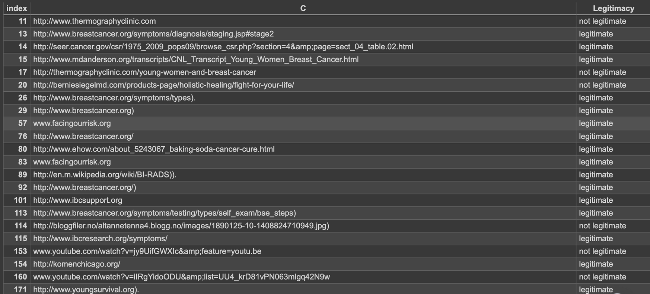
URL’s

Slide 7
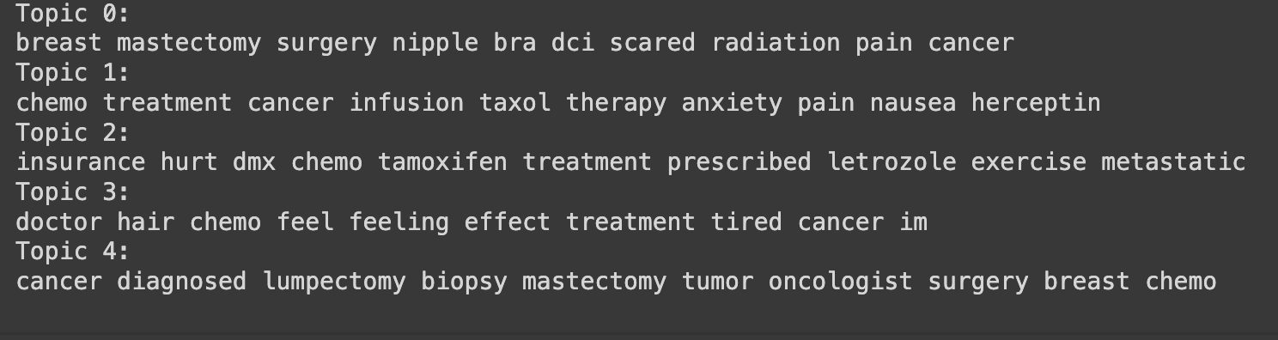
LDA Topic Clusters

Slide 8
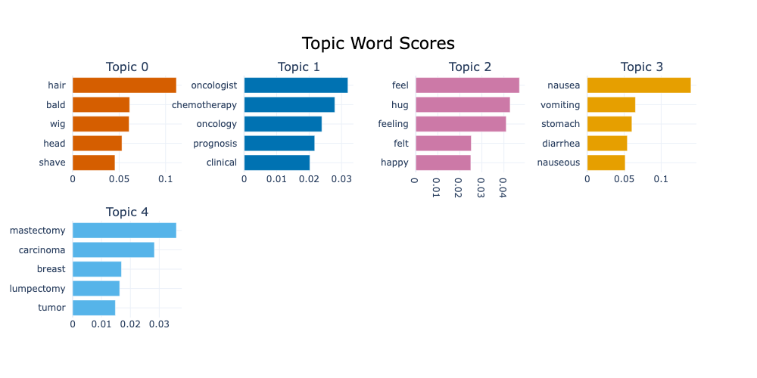
BERT Topics

Slide 9

Clusters on doing Emotion Analysis
cluster value : 0(Things to keep happy)
value 1: love idea repost another subreddit since isnt lot traffic one
value 2: lot different appointment bc different procedure etc know going appointment fairly mundane didnt really require moral support others like chemo best bet offer support leave want come along ask dont offended doesnt
value 2: thats sweet take care hard time accepting help eventually succumb fact wasnt going normal thing could specific willing help laundry dish take dog walk day may want day wont day may want house room chemo effect everyone differently physically cancer effect everyone emotionally mentally prepared possible intense conversation good luck come back question.
cluster value : 1
value 1: mom always coarse thick wavy hair chemo treatment hair grew back magnificent curl really soft shiny
value 2: possibly recently read good article breast cancer young woman
value 2: also nice precise risk assesment tool breast cancer young woman thermography stated link check useful information
cluster value : 2
value 1: ask would like supported make feel like you’re always
value 2: ill keep eye response one keep encouraging get tested im sure yet
value 2: would awesome hope work

Slide 10
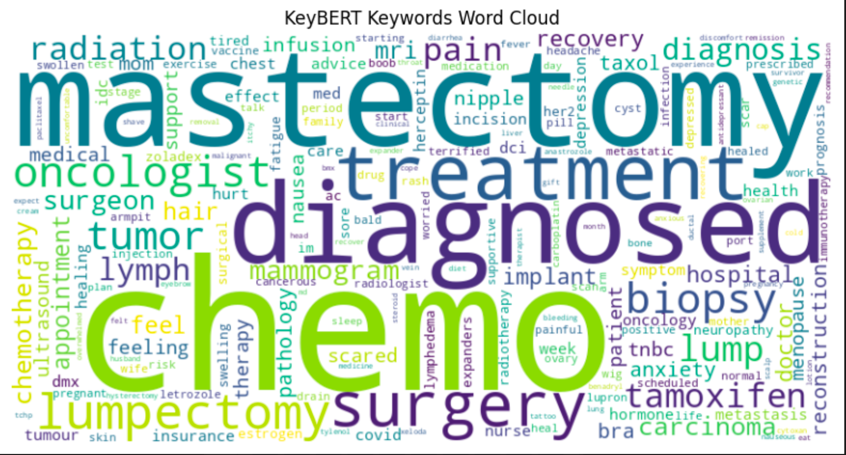
Word Cloud

Slide 11

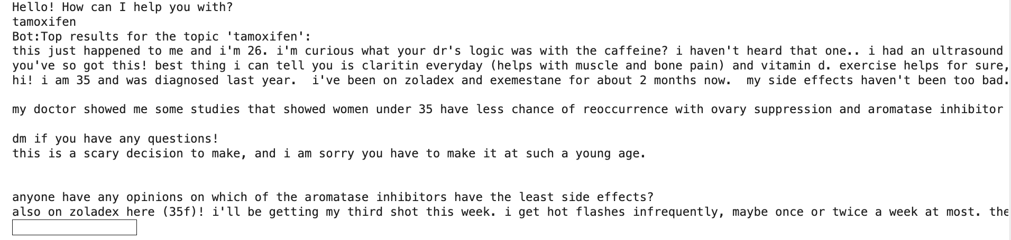

Q & A Chat bot

Slide 12
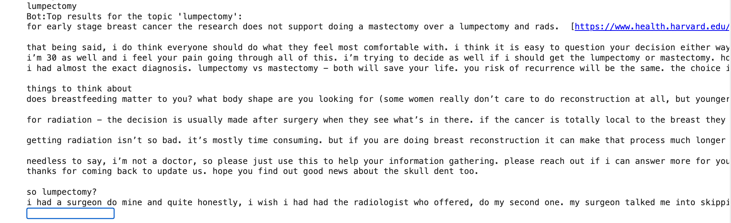
Q & A Chat bot

Slide 13
Challenges and Solutions
We will try to pull out advice from comments by using Named Entity
Recognition and by using contextual analysis
We tried unsupervised clustering for emotion analysis using kmeans. As next step we will proceed with labelling the comments using gpt and use it for emotion analysis
For Q&A model, we can’t perform chatbot with topic modelling alone. Instead we opted Topic Modelling with K-mean

Slide 14



THANK YOU

